Slide 1
Diagnosis of Diabetes using a weight adjusted voting of an Ensemble
BY Trilok Suresh
Mentor – Dr. lin li

Slide 2
Motivation
Diabetes Stats:
As of 2015 415 million people have diabetes worldwide
7th leading cause of death in US
2012 : ~30 million Americans were Diabetic
30% were Undiagnosed
Highlights: “Weight Adjusted voting of an Ensemble”

Slide 3
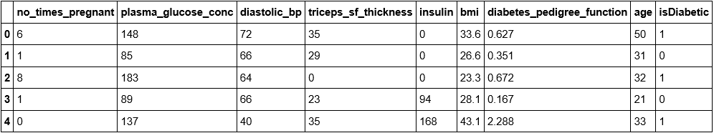
The Dataset
Google search – “pima Indian diabetes dataset”

Slide 4
The Approach
Weight Adjusting
Trained Classifiers
Weights for each of the classifiers
Dataset 2
Predictions
Classifier 1
Classifier 1
Predictions
Dataset 1
Classifier 2
Classifier 2
Predictions
Voting
Dataset 3
Predictions
Diagnosis Decision
Predictions
Classifier n
Classifier n
Predictions
Training the classifiers

Slide 5
The Weight Adjusting algorithm
if (the number of positive votes > = majority)
{
weight of each correct classifier + = step_size1 / (#of correct classifiers / #of incorrect classifiers) weight of each incorrect classifier - = step_size1
}
Else
{
weight of each correct classifier + = (# of incorrect classifiers /# of correct classifiers) * step_size2
weight of each incorrect classifier - = step_size2
}
Ex: 1 1 1 0 0
Ex: 1 1 0 0 0

Slide 6
The Voting algorithm
# of Positive votes
# of Negative votes
Decision of the Ensemble
3
0
Diabetic
3
2
Diabetic
Diabetic, if the average weight of the positive voters is greater than the average weight of negative voters.
Healthy otherwise.
2
3
2
2
0
5
Healthy

Slide 7
Results
Classifier | Accuracy | Sensitivity | Specificity
Naïve Bayes | 78.0991 % | 63.8554 % | 85.5345 %
LDA | 80.5785 % | 59.0361 % | 91.8238 %
ADA | 74.3801 % | 56.6265 % | 83.6477 %
Support Vector Machines | 78.9256 % | 53.0120 % | 92.4528 %
Random Forests | 76.8595 % | 42.1686 % | 94.9685 %
Classifier | Accuracy | Sensitivity | Specificity
Ensemble of 5 classifiers | 80.0256 % | 66.2650 % | 85.5345 %

Slide 8
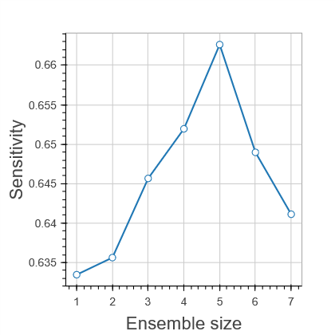
Results

Slide 9
Challenges
Imbalanced Class Distribution
Very few samples – 768 only!!

Slide 10
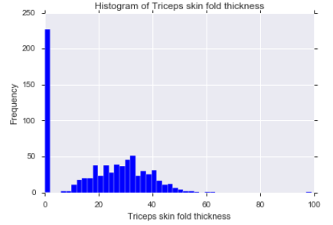
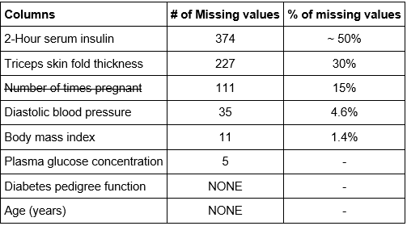
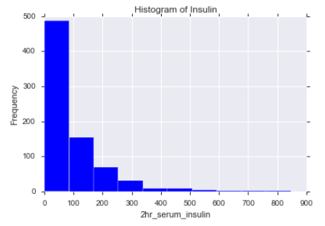
Challenges Contd.
Missing values

Slide 11
Future work
Try data Imputation – fill in missing values using regression
Feature Selection
Handle Outliers
Try other Diabetes Datasets
Extend it to work for other Diseases ex: Cancer etc.

Slide 12
What I Learned
Machine Learning
Automated Pipeline
Matlab/Octave
Python
Scikit-Learn, Ipython, Pandas, Numpy

Slide 13
Conclusion
The Weight Adjusted voting approach is really efficient in increasing the performance of the model
With a complete dataset (no missing values) and sufficient enough samples this model can be very successful and can be used in real time
“If Humans can do it Machines can do it too!”

Slide 14
References
“Diagnosis of Diabetes using a Weight-Adjusted Voting Approach” - Lin Li, the Proceeding of 14th IEEE International Conference on Bioinformatics and Bioengineering (BIBE 2014), pp. 320 - 324, Boca Raton, Nov 10 - 12, 2014.
https://archive.ics.uci.edu/ml/datasets/Pima+Indians+Diabetes
Coursera.com – “Machine Learning” by Andrew Ng (MOOC)
http://scikit-learn.org/stable/
http://pandas.pydata.org/
Anaconda - https://www.continuum.io/documentation

Slide 15
Thank You!

